Slide 1
Model-driven Engineering
Source of most materials:
Xiwei Xu, Ingo Weber, and Mark Staples. Architecture for Blockchain Applications. Springer, 2019

Slide 2
What will you learn today
Model-Driven Engineering basics
MDE for data and token model
MDE for process models

Slide 3
Model-Driven Engineering basics

Slide 4
Motivation for MDE
Blockchain is still a relatively new technology with limited tooling and documentation, skill set is rare
According to a survey by Gartner, “23% of [relevant surveyed] CIOs said that blockchain requires the newest skills for implementation at various application areas, while 18% said that blockchain technique itself is one of the most difficult.”¹
Mistakes in smart contracts have led to massive economic loss, such as the DAO exploit
According to an ACS / Data61 report from 2019: 14 jobs per blockchain developer²
[1] Gartner Press Release. Gartner Survey Reveals the Scarcity of Current Blockchain Deployments. (3 May 2018). https://www.gartner.com/newsroom/id/3873790
[2] Bratanova, A., Devaraj, D., Horton, J., Naughtin, C., Kloester, B., Trinh, K., Weber, I., Dawson, D. (2019) Blockchain 2030: A Look at the Future of Blockchain in Australia. CSIRO Data61: Brisbane, Australia. https://www.researchgate.net/publication/332298704_Blockchain_2030_A_Look_at_the_Future_of_Blockchain_in_Australia
Notes:
Blockchain has attracted a broad range of interests from start-ups, enterprises and governments. A large number of projects have been conducted to explore how to use blockchain to re-architect systems and to build new applications and business models. The application areas for blockchain are diverse, including digital currency, payments, trade finance, asset registry, identity management, and business processes.
However, building blockchain applications is challenging for developers. First, blockchain is a new technology with still limited tooling and documentation, so there can be a steep learning curve for developers. According to a survey by Gartner [1], 23% of [relevant surveyed] CIOs said that blockchain requires the newest skills for implementation at various application areas, while 18% said that blockchain technique itself is one of the most difficult. Second, the blockchain is by design an immutable record, so it is non-trivial or even infeasible to update the smart contracts . This can impede the way to fix bugs by releasing new versions of smart contracts. Mistakes in smart contracts have led to massive economic loss, such as the DAO exploit [2].

Slide 5
Model-driven Engineering
A methodology for using models at various levels of abstraction and for different purposes during software development
Often concern-specific or domain-specific modelling languages
“Architecture-centric MDE”: architecture is the domain
Text-based or graphical modelling notations can be used (i.e., not necessarily graphical)
Can cover static structures (like data models) or dynamic behaviour (like activity sequences)
Requires you to formalize the architecture, can be an “architectural catalyst”
Helps to get a usable blueprint of the system
Makes architecture models immediately useful & motivates up-to-dateness
Architecture diagrams become technical artefacts of the system
MDE can increase code quality and, even when starting from scratch, pay off within weeks

Slide 6
Model-driven Engineering – Modelling levels
Models are abstractions; what to model and what to abstract depends on the purpose
“[A] model which took account of all the variegation of reality would be of no more use than a map at the scale of one to one.” Joan Robinson, 1962
Low-level models: production code can be directly derived from the models
High-level models: means of communication between business owners and developers implementing a system
Intermediate levels can support model-based system analysis or system management tools
Recall cost models from Lecture 12
Any level: can generate some of the code:
Code skeleton or early version of the code
Glue code and boilerplate code

Slide 7
MDE vs. MDD vs. MDA
Model-driven development (MDD) vs. MDE:
The parts of MDE that focus on code generation: MDD
Think of software engineering vs. software development
Model-driven architecture (MDA) vs. MDD/MDE:
OMG’s standard for MDE, using OMG modelling languages – primarily Unified Modeling Language (UML)
https://www.omg.org/mda/
Does not cover all aspects of an architecture, but architecture-centric models
Foundation standard: Meta-Object Facility (MOF) – see next slide
Other prominent concepts:
Platform-Independent Model (PIM)
Platform-Specific Model (PSM)
Transformations: model-to-model or model-to-code

Slide 8
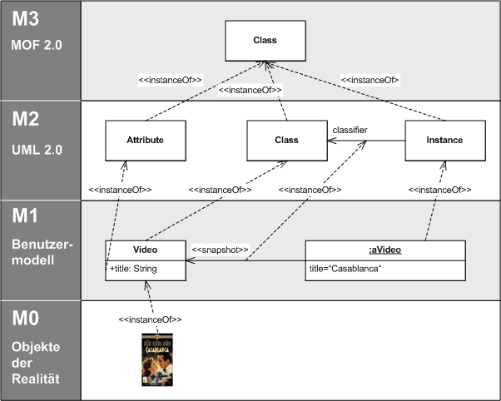
Meta-Object Facility (MOF)
User-defined model
Real-world objects
Adapted from https://en.wikipedia.org/wiki/Meta-Object_Facility

Slide 9
Advantages of MDE in the blockchain context
Code generation can implement best practices and well-tested building blocks
Code can adhere to blockchain “standards” (like ERC-20, ERC-721, …)
Improved productivity, especially for novices in a particular technology
However: someone should understand the code and review it
Models can be independent of specific blockchain technologies or platforms
Avoid lock-in to specific blockchain technologies
Models are often easier to understand than code – particularly useful in communicating with business partners about smart contracts
Facilitates building trust
Domain experts can understand how their ideas are represented in the system
Business owners can better assess if smart contract (from a model) is acceptable

Slide 10
MDE for Data and Token model

Slide 11

Fungible and Non-fungible Tokens
Recap
Fungible tokens: interchangeable
E.g., $2 coin, $10 note
Main concern: how many?
Ethereum: ERC20 standard
https://theethereum.wiki/w/index.php/ERC20_Token_Standard
Example: OmiseGO (OMG).
“The OmiseGO blockchain comprises a decentralized exchange, liquidity provider mechanism, clearinghouse messaging network, and asset-backed blockchain gateway. … It uses the mechanism of a protocol token to create a proof-of-stake blockchain to enable enforcement of market activity amongst participants. Owning OMG tokens buys the right to validate this blockchain, within its consensus rules.”
Non-fungible tokens
E.g., houses, cars, patents
Main concern: which ones?
Ethereum: ERC721
https://github.com/ethereum/EIPs/issues/721
Example: cryptokitties https://www.cryptokitties.co/
Kitties are non-fungible, individual, and their appearance depends on the individual features

Slide 12
MDE for data structures and tokens
Approach:
Enter high-level information
Model data structure (variables, types) – not for fungible tokens
Model relationships to other types / tokens
Select features
→ Code is generated – deploy directly or customize
Feature examples:
Fungible tokens:
Can be minted? Burnt? By whom?
Non-fungible tokens
Include standard method(s) for sale
One contract for all tokens or one per token?
Code generated is compliant with standards
→ interface syntax and semantics

Slide 13



Student Task
Individually (2 minutes):
Open a new page / entry in your note pad / note-taking app
Think about what data to model for exam registration
Write down your top 6-10 data fields
Discuss with your breakout group (5 minutes):
Which data fields to keep, for on-chain storage in a permissioned ledger
Think about any case-specific functions that a generic tool might not support & write them down

Slide 14
Data61 tool: Lorikeet
Lorikeet: automatic generate smart contracts from BPMN models/registry data schema
Publication: Qinghua Lu, An Binh Tran, Ingo Weber, Hugo O'Connor, Paul Rimba, Xiwei Xu, Mark Staples, Liming Zhu, and Ross Jeffery. Integrated model-driven engineering of blockchain applications for business processes and asset management. Software: Practice and Experience, 51(5):1059-1079, 2021. https://arxiv.org/abs/2005.12685

Slide 15
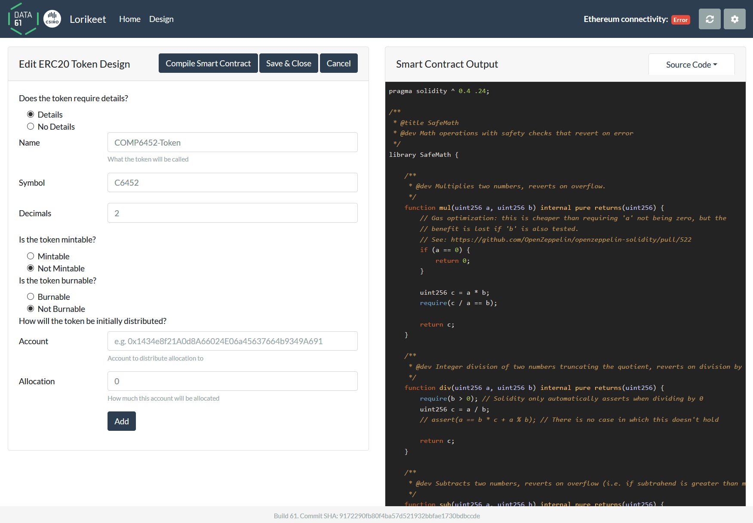
Design time for fungible tokens

Slide 16
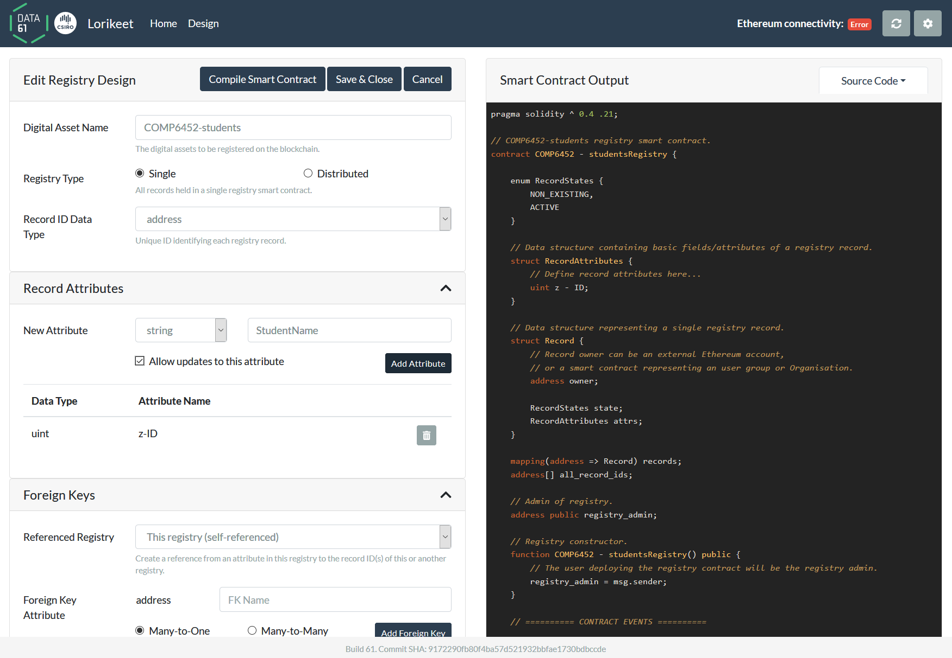
Design time for data models / non-fungible tokens

Slide 17
MDE for process models Note: students are expected to have basic knowledge of BPMN

Slide 18
MDE for Processes – Motivation
Integration of business processes across organizations: a key driver of productivity gains
Collaborative process execution
Doable when there is trust – supply chains can be tightly integrated
Problematic when involved organizations have a lack of trust in each other → if 3+ parties should collaborate, where to execute the process that ties them together?
Common situation in “coopetition”

Slide 19
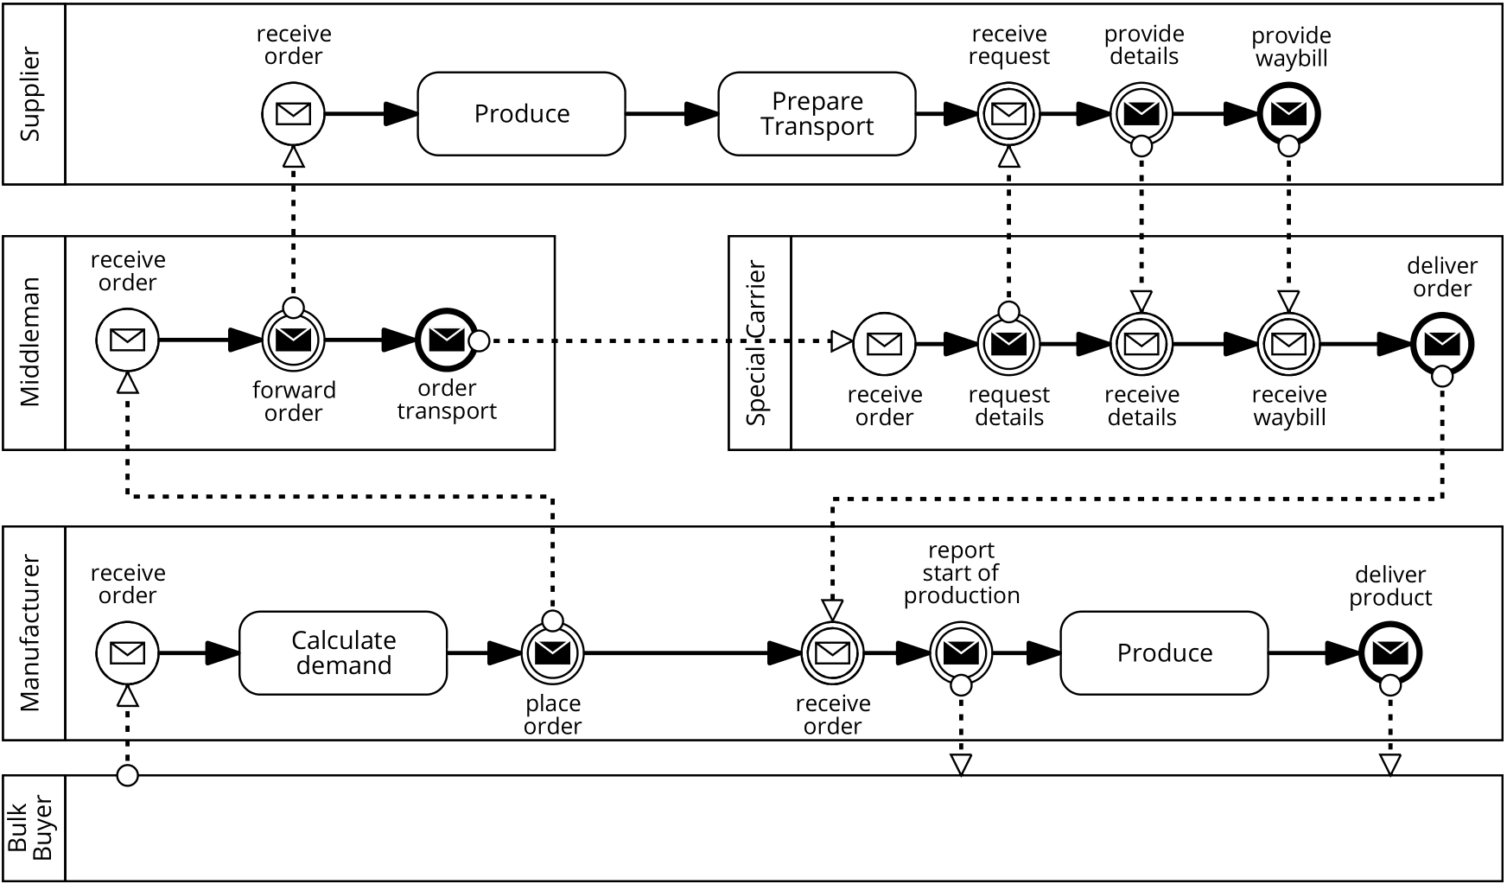
Motivation: example
Issues:
Knowing the status, tracking correct execution
Handling payments
Resolving conflicts

Slide 20
Approach in a nutshell
Goal: implement collaborative business processes as smart contracts
Translate (enriched) BPMN to smart contract code
Triggers act as bridge between Enterprise world and blockchain
Smart contract provides:
Independent, global process monitoring
Conformance checking and process enforcement: only expected messages are accepted, only from the respective role
Automatic payments & escrow
Data transformation
Encryption
Processes can make use of data / token contracts
Process activity to hand over title to a car / shipment / grain / ..., e.g., in exchange for fungible tokens

Slide 21
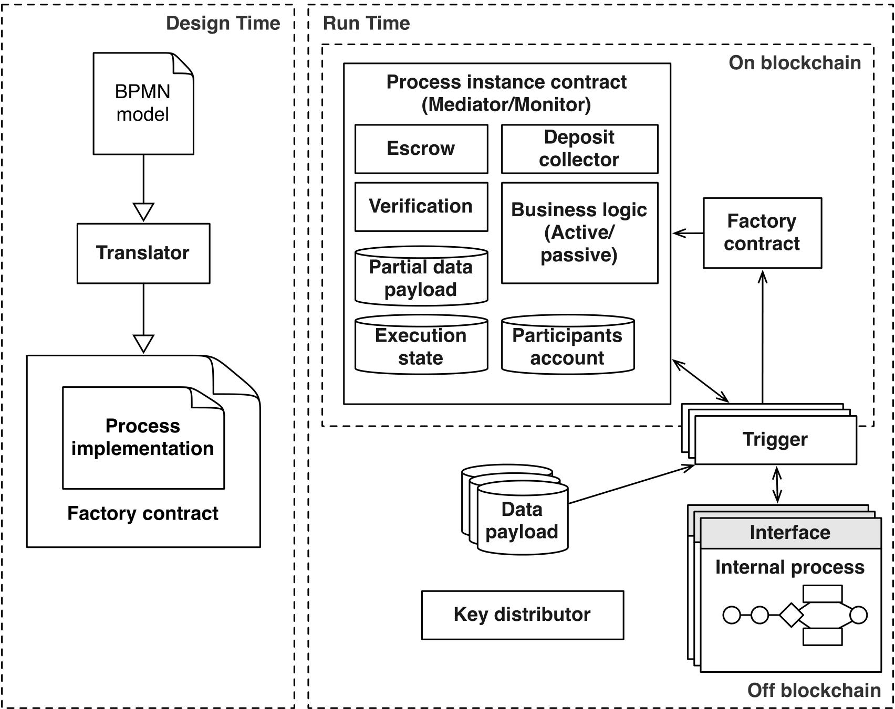
Architecture overview

Slide 22
Runtime
Instantiation:
New instance contract per process instance
Assign accounts to roles during initialization
Exchange keys and create secret key for the instance
Messaging:
Instead of sending direct Web Service calls: send through triggers & smart contract
Instance contract handles:
Global monitoring
Conformance checking and model enforcement: execution cannot deviate from model
Automated payments*
Data transformation*
(*: optional, if certain assumptions are met)

Slide 23
Runtime – UML Sequence Diagram

Slide 24
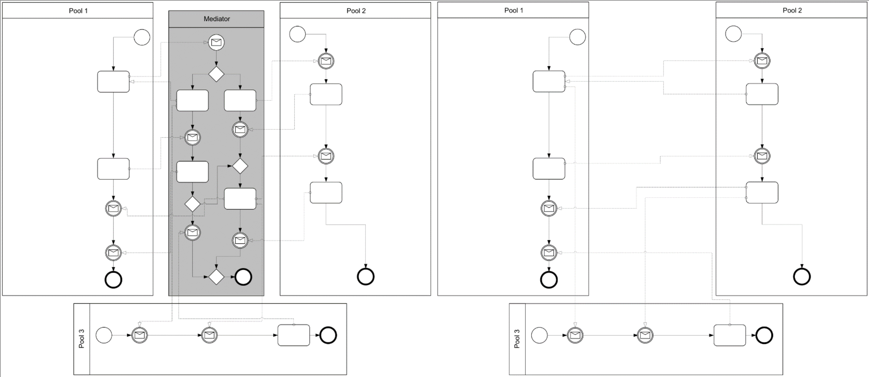
Collaborative processes: variants
Mediator (orchestration) Choreography → C-Monitor

Slide 25
Translator
Translate subset of BPMN elements to Solidity
BPMN Choreography diagrams or regular BPMN models with pools
BPMN Choreography diagram example:

Slide 26
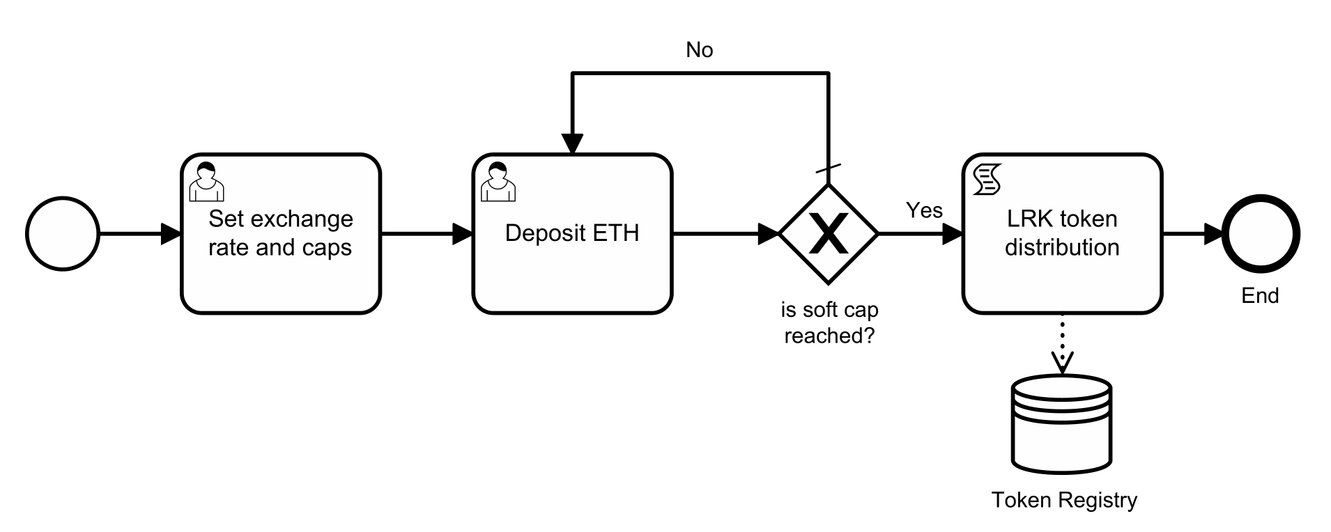
Combining process and data/token models Example: ICO process

Slide 27
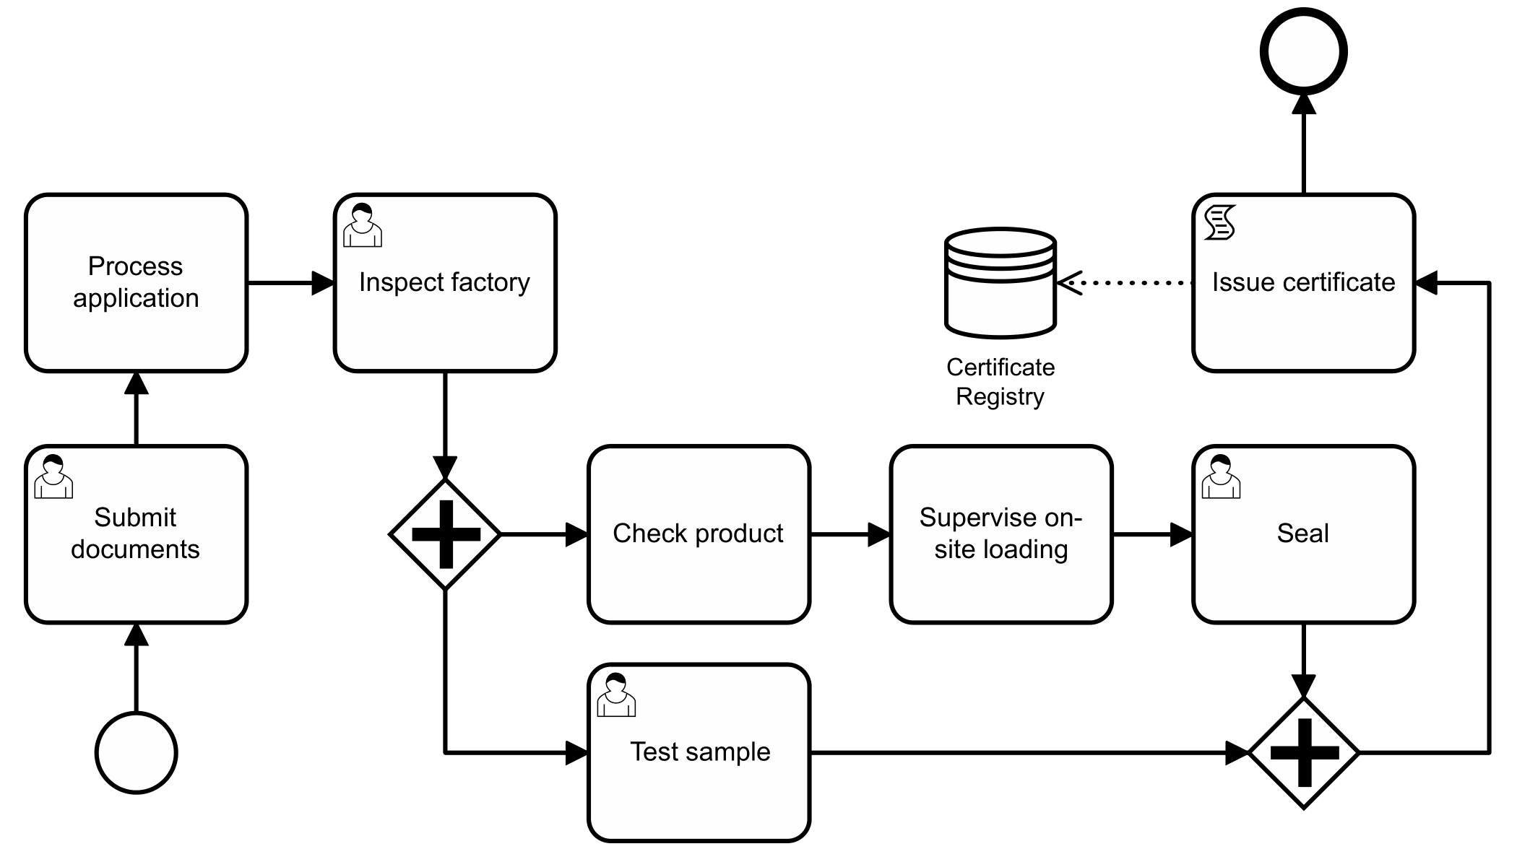
Combining process and data/token models Example: quality tracing process

Slide 28
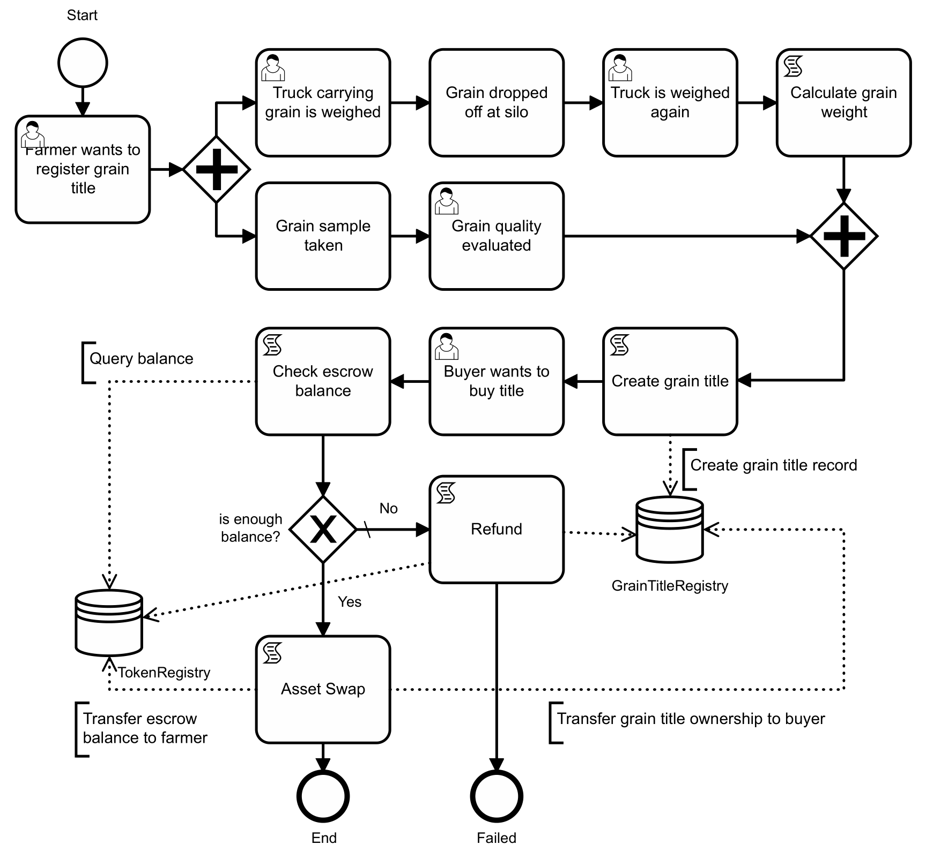
Combining process and data/token models Example: grain sales process

Slide 29
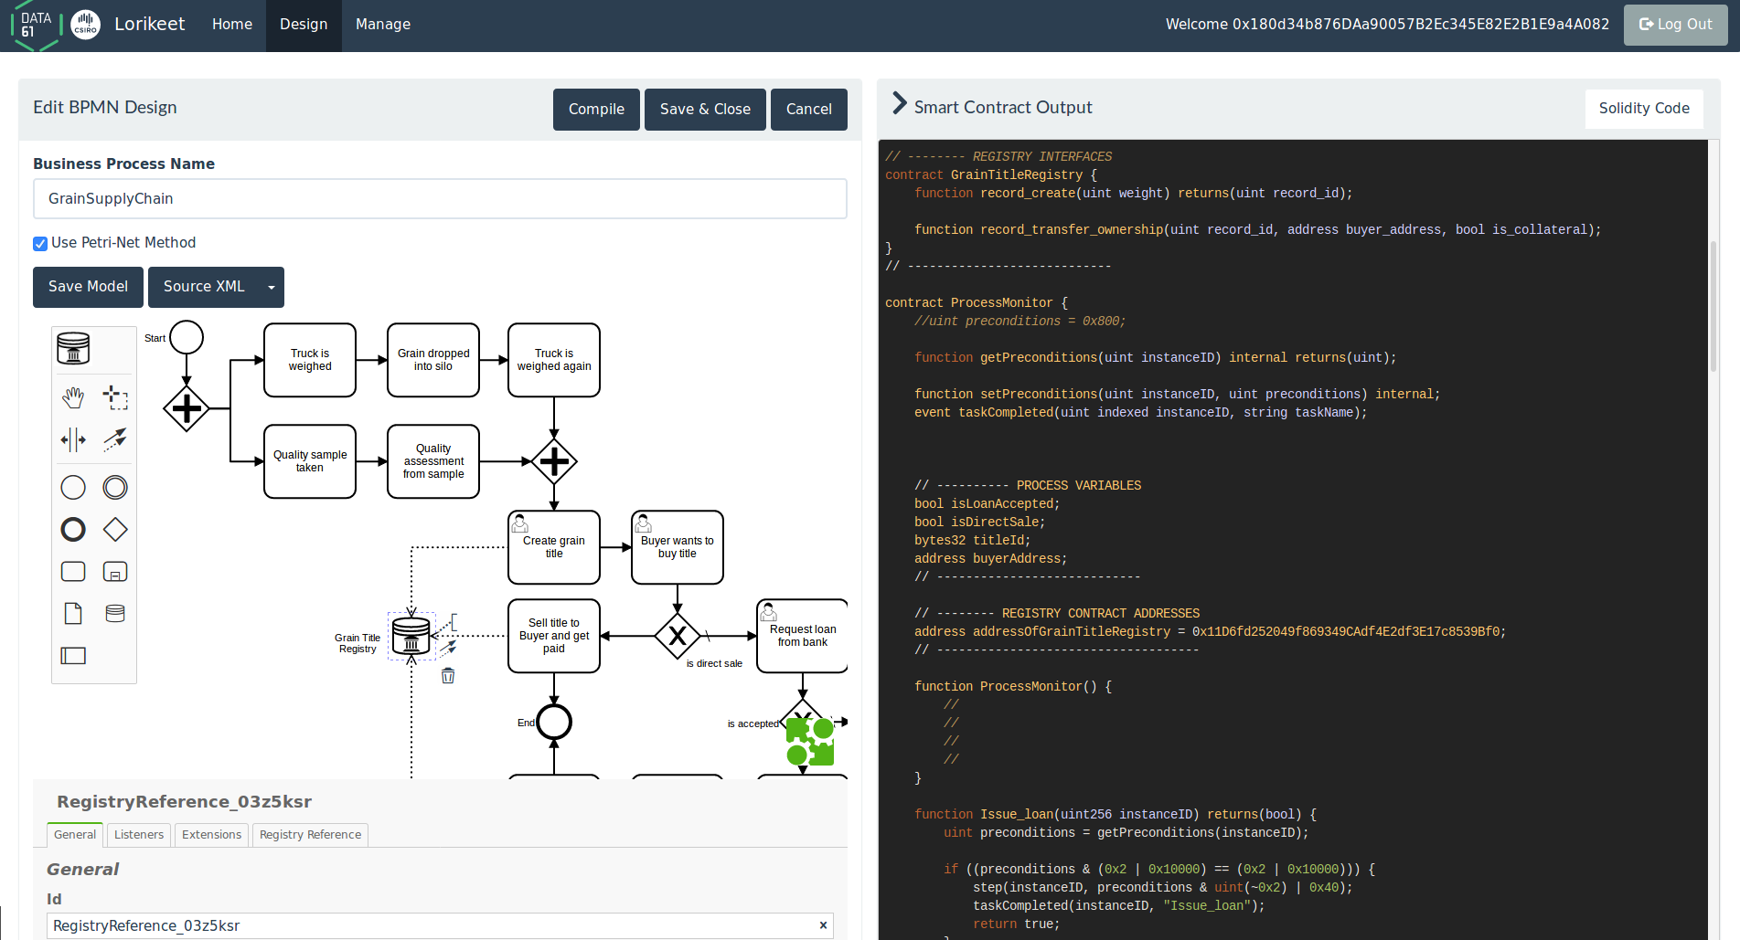
Tooling: Design time (Lorikeet)
Demo video: https://drive.google.com/file/d/1rpy-oHbDVkXa6u4Fn73wSX8rINn1sv3U/view

Slide 30
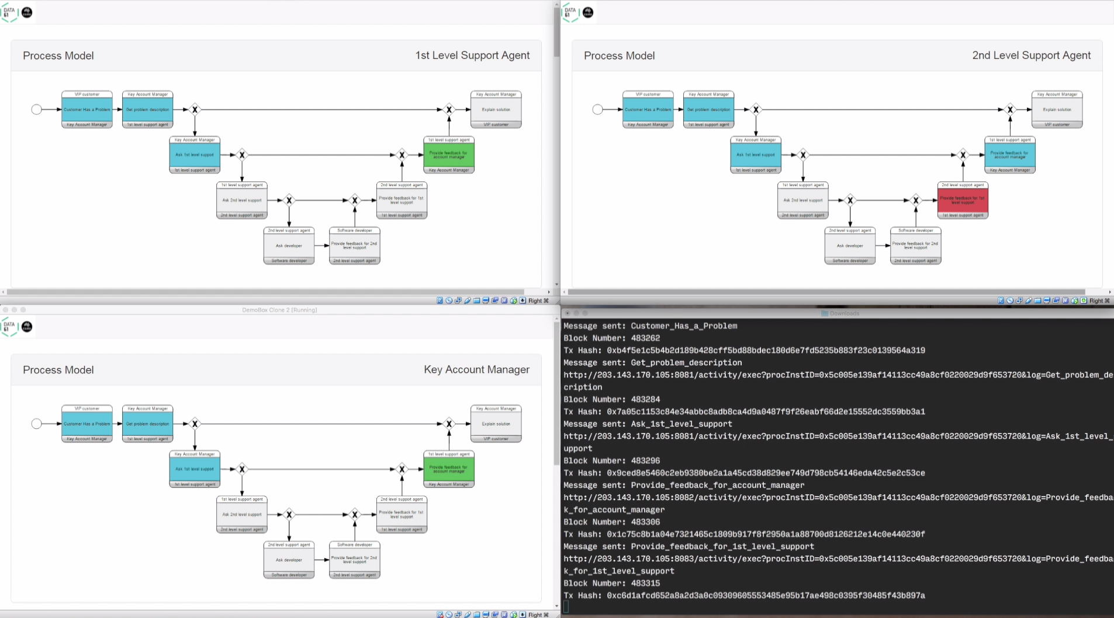
Tooling: Runtime

Slide 31
Summary: - Model-Driven Engineering basics - MDE for data and token model - MDE for process models

Slide 32
MDE & related tools for blockchain
Lorikeet (and its predecessor Regerator & BPM work)
Tools are not publicly available, but lots of information/papers on our website: https://research.csiro.au/data61/blockchain/
Caterpillar – open-source BPMN execution engine (Uni Tartu & Data61)
https://github.com/orlenyslp/Caterpillar
Regis – registry generator
https://regis.nu/
Hyperledger Composer – for HLF business networks
https://www.hyperledger.org/projects/composer
Other organisations (including Consensys) are working on tools, but most are not publicly available as yet

Slide 33
Model-driven Engineering
Source of most materials:
Xiwei Xu, Ingo Weber, and Mark Staples. Architecture for Blockchain Applications. Springer, 2019

